Slide 1



Intermittent and Continuous Operation of an Off-Grid Solar Nanofiltration System
Abby Haan, Chaz Alvarez, Lynn Carroll, Hunter Gudenkauf, Doorae Lee, Jose Navarrete, and Vasiliki Karanikola
2024 NASA Space Grant Symposium
Tucson, Arizona
April 20, 2024
Notes:
Introduce myself, title, u of a. This system is applicable to any scenario where you need to treat water, but we are specifically working on it with the Navajo Nation.

Slide 2
Background
Challenges facing the Navajo Nation:
  Water connections: many homes do not have city water connections
    Many people haul water, which has two main issues:
      Contaminants: high ion concentrations and uranium
      Cost: $13.30/100 gal to haul vs. $0.80/100 gal in the city
  Electricity: many of these homes also are not connected to the electrical grid
Chief, Karletta, et al. “Addressing Food-Energy-Water Insecurities of the Navajo Nation through University-Community Collaboration.” Water Resources IMPACT, vol. 23, no. 1, Jan. 2021, pp. 31–33, https://doi.org/https://wrrc.arizona.edu/sites/wrrc.cals.arizona.edu/files/2022-10/Chief_et_al_WWPs_AWRA_IMPACT.pdf.
Heminger, Grant, et al. “Northern Arizona Water Affordability Study.” University of Arizona Cooperative Extension, 2023, pp. 16, extension.arizona.edu/sites/extension.arizona.edu/files/attachment/nrulpc-northern-arizona-water-affordability-study.pdf.
Notes:
These are the challenges many people in the Navajo Nation face.

Slide 3
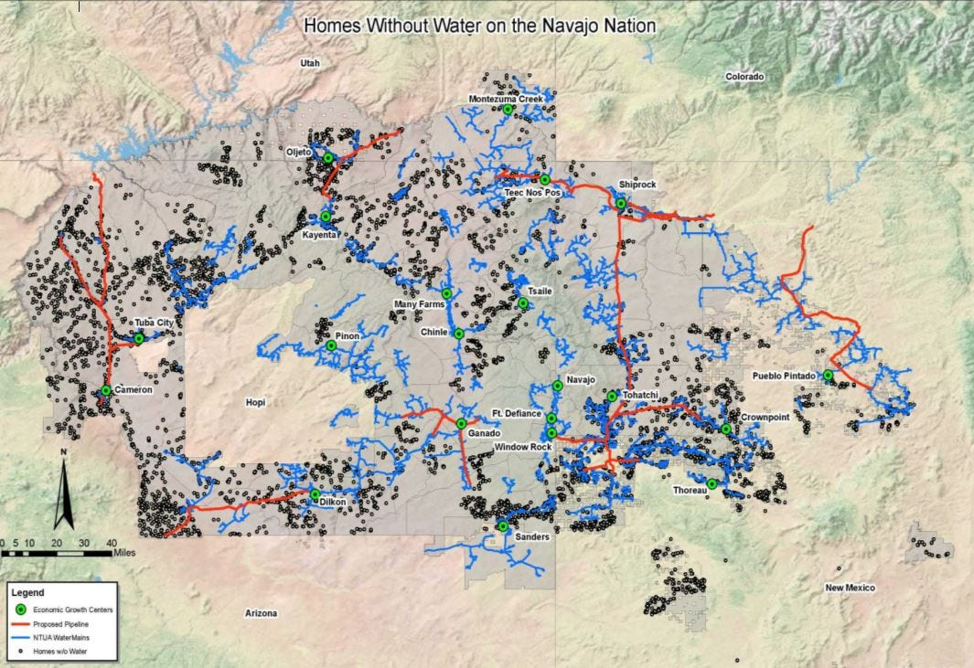
Water Connections
3
Chee, Ronson. “Ronson Chee: Covid-19 Pandemic Exposes Long-Standing Issues on Navajo Nation.” Indianz, 13 May 2020, indianz.com/News/2020/05/13/ronson-chee-covid19-pandemic-exposes-lon.asp.
Notes:
The black dots represent homes without city water connections. Blue lines are current water lines. Red lines are proposed water lines.

Slide 4
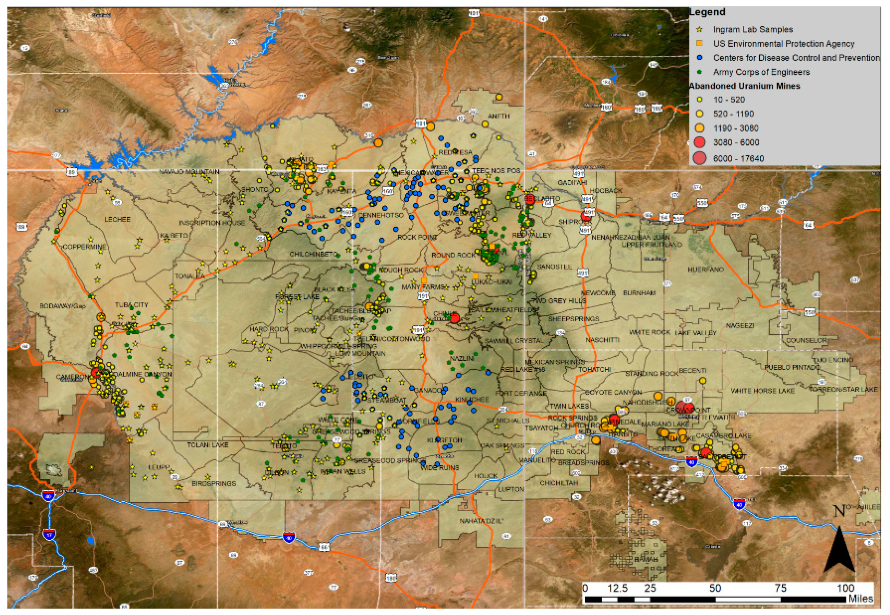
Abandoned Uranium Mines
4
Credo, Jonathan, et al. “Quantification of Elemental Contaminants in Unregulated Water across Western Navajo Nation.” International Journal of Environmental Research and Public Health, vol. 16, no. 15, 31 July 2019, https://doi.org/https://doi.org/10.3390/ijerph16152727.
Notes:
Each of the yellow, orange, and red circles on this map represents an abandoned uranium mine in the Navajo Nation. The yellow stars, orange squares, and blue and green circles represent water sample sites. In order to address all of these issues, we have created the solar nanofiltration system.

Slide 5
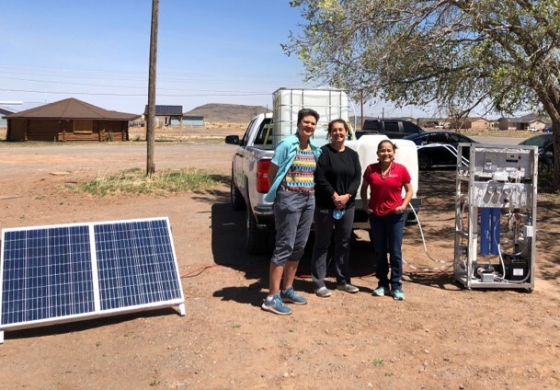
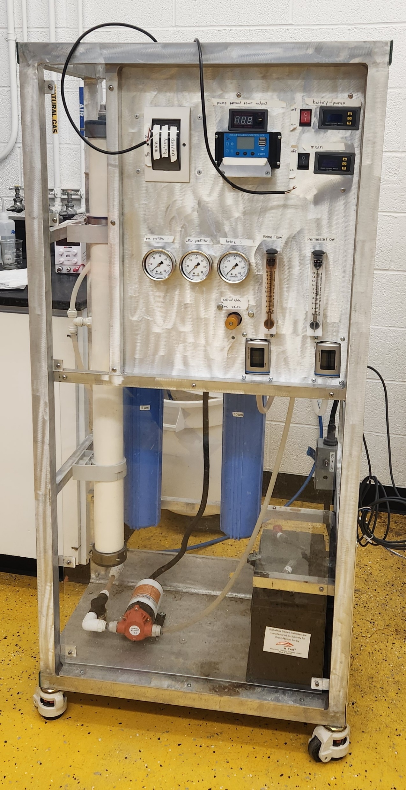
Solar Nanofiltration System
5
Notes:
An image of our system being installed in someone’s home in the Navajo Nation.
An image of the system being tested in the lab.

Slide 6
Solar Nanofiltration System
Feed tank
10 μm 5 μm
Nanofiltration membrane
Purified stream
Concentrated stream
Sample
6
Notes:
The SNF system contains three major parts: the feed tank, prefilters, and nanofiltration membrane. In experiments, we recycle the purified and concentrated stream. In the field, you would drink the purified stream.

Slide 7
Solar Nanofiltration System
Feed tank
10 μm 5 μm
Nanofiltration membrane
Purified stream
Large particles
Divalent ions
Concentrated stream
Monovalent ions
Water
Sample
Feed tank
7
Notes:
The feed tank contains the initial solution, which can contain many things, like large particles, divalent ions (like calcium and magnesium), monovalent ions (like chloride), and water.

Slide 8
Solar Nanofiltration System
Feed tank
10 μm 5 μm
Nanofiltration membrane
Purified stream
Large particles
Divalent ions
Concentrated stream
Monovalent ions
Water
Sample
10 μm and 5 μm
filters
8
Notes:
The 10 and 5 micron prefilters reject most of the large particles, while allowing everything else through.

Slide 9
Solar Nanofiltration System
Feed tank
10 μm 5 μm
Nanofiltration membrane
Purified stream
Large particles
Divalent ions
Concentrated stream
Monovalent ions
Water
Sample
Nanofiltration
membrane
9
Notes:
The nanofiltration membrane rejects all of the large particles and most of the divalent ions, like calcium. It allows water, monovalent ions, and a few divalent ions through.

Slide 10
Experimental Goal
Comparing intermittent and continuous operation
  Intermittent mimics field operation
  Continuous mimics industry operation
Looking specifically at water flux and ion rejection
  Flux: flow through membrane surface area
    Units: volume/(time*area)
  Rejection: percentage of an ion that does not pass through membrane
    Units: percent
10
Notes:
This experiment compared continuous and intermittent operation of the system. Continuous operation is more common in industry settings as processes are run 24/7. In the field, our system is run intermittently, as people only need to filter smaller batches at a time. In this experiment, we were looking specifically at flux and ion rejection. Flux is water flow through the membrane surface area, with units of volume over time times area. Rejection is the percentage of ions that do not pass through the membrane (or are removed from the clean water produced).

Slide 11
Methods
Run system: 24 L CaCl₂ and MgSO₄ solution
  Intermittent: 5 hours/day for 18 days
  Continuous: 24 hours/day for 8 days
Collect samples
  Intermittent: beginning and end of each day
  Continuous: every 8 hours
Analyze samples
  Ion chromatography (IC): measures ion concentrations
11
Notes:
In order to do this, we ran a 24 L solution of calcium chloride and magnesium sulfate through the system. For the intermittent runs, we did 5 hours a day for 10 days. We collected samples at the beginning and end of each run. For the continuous run, we did 24 hours a day for 8 days. We collected samples every 8 hours. All of these samples were analyzed using ion chromatography, which measures ion concentrations in a solution.

Slide 12
Results
Experiment | Calcium rejection
Continuous | 65.6%
Intermittent | 61.5%
  Decrease in average calcium rejection from continuous to intermittent
12
Notes:
Review rejection
Describe everything in table → we saw less rejection in the intermittent experiment
**Why??

Slide 13
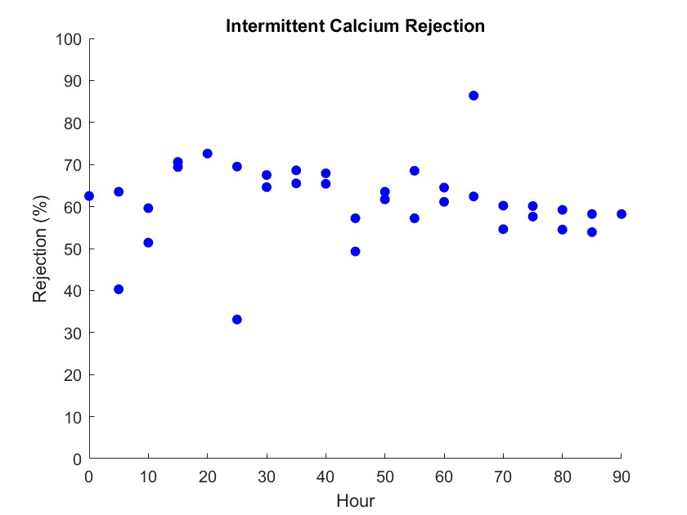
Results
Experiment | Calcium rejection
Continuous | 65.6%
Intermittent | 61.5%
  Decrease in average calcium rejection from continuous to intermittent
13
Notes:
Describe graph axes

Slide 14
Results
Experiment | Calcium rejection
Continuous | 65.6%
Intermittent | 61.5%
  Decrease in average calcium rejection from continuous to intermittent
  Change in calcium rejection at start of each week
14
Notes:
There was a change in calcium rejection at the beginning of each week. There was no specific trend here, sometimes it increased and sometimes it decreased. This is something worth noting that we would like to explore in future experiments.

Slide 15
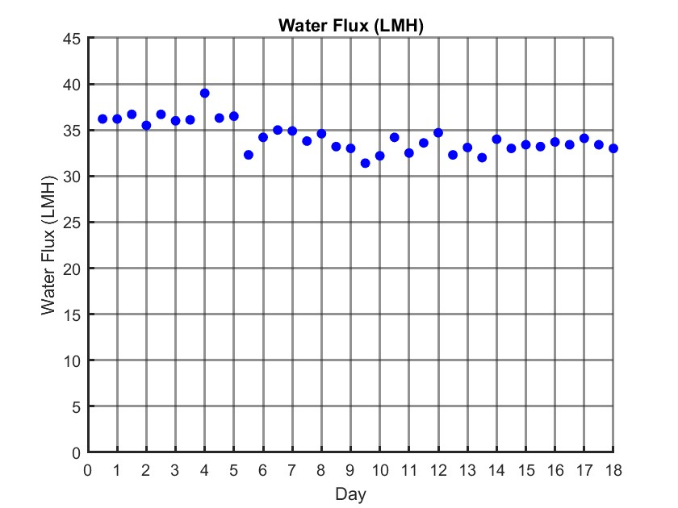
Results
15
Notes:
Review flux
Describe graph contents and axes

Slide 16
Results
  Decrease in water flux at start of most days
16
Notes:
We saw a decrease in water flux at the start of most days. This is represented by the values between the grid lines and is more obvious in the later runs.
Probably due to buildup overnight on the membrane: we did not rinse the system after each run.

Slide 17
Results
  Decrease in water flux at start of most days
  Decrease in water flux at start of some weeks
17
Notes:
Decrease in water flux at start of some weeks, due to longer downtime allowing more buildup on the membrane.

Slide 18
Results
  Decrease in water flux at start of most days
  Decrease in water flux at start of some weeks
  Decrease in water flux over entire experiment
18
Notes:
Again due to buildup as the experiment continues and we have solution in there every day.

Slide 19
Conclusions
  Intermittent operation overall reduces water flux and calcium rejection
  These results help us understand the limitations of system and boundaries of its performance
19

Slide 20
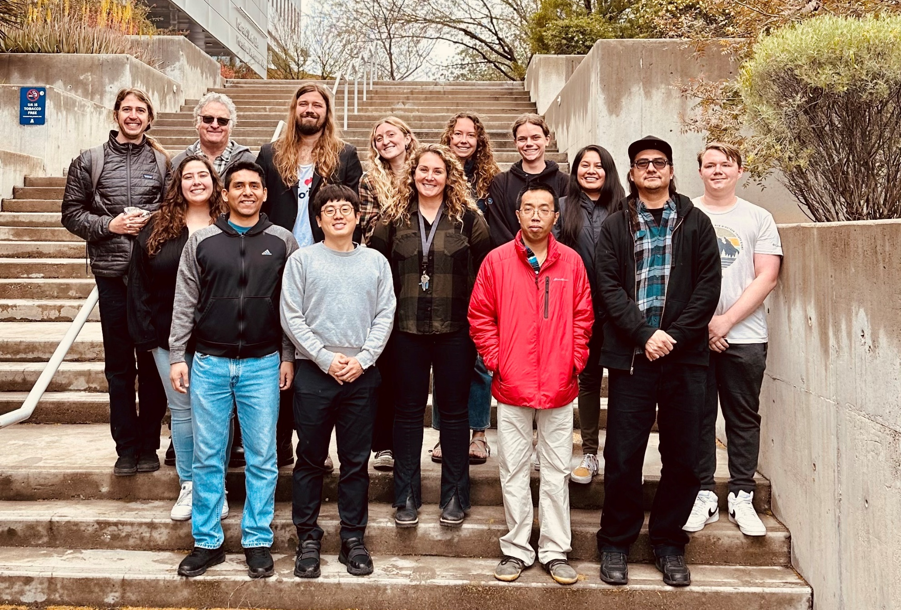


Acknowledgments
  Thank you to Space Grant, the Haury Foundation, and the Waverley Street Foundation for funding my research, everyone on the SNF team for all their help, especially Lynn for her exceptional organization and coordination skills, and Vicky for her advice and guidance on all aspects of our projects!
20

Slide 21
Thank you!

